Slide 1

UiPath voice & text converter
Automation created by Henry Wang
April 2021

Slide 2
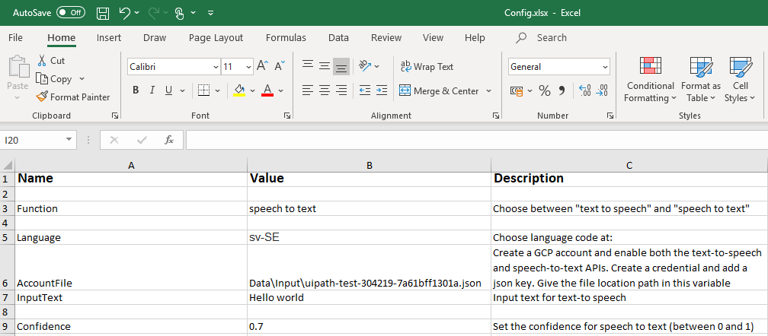
Functionality
Two functionalities
This automation includes two functionalities. To choose which one to use (and to edit other settings such as language), please find the excel configuration file under the file path “Data\config.xlsx”
The two functionalities are as following:
Convert speech to text
Convert text to speech

Slide 3
Functionality
Speech to text
The speech to text functionality recognizes sound inputs (speech) and converts it into text using artificial intelligence APIs from Google Cloud Platform. Note that an account is required for automation to function.
The output can be found in the output field of UiPath studio.
Please note that the input language has to be configured before starting the recording in the excel configuration spreadsheet. The default language has been set to Swedish.

Slide 4
Functionality
Text to speech
The text to speech functionality works by inputting any text string in the configuration excel spreadsheet. This will be read out loud by UiPath.
Please note that the input language has to be configured before starting the recording in the excel configuration spreadsheet. The default language has been set to Swedish.

Slide 5
Notes
This automation utilises the GCP API for converting text-to-voice or voice-to-text. These APIs need to be enabled first before using. Create your own credential (json-file) at GCP platform. Write the file path location in config file at Data\Config.xlsx.
This automation requires the package named "UiPath.Googlespeech.Activities"
Author: Henry Wang
Please don’t hesitate to contact me on LinkedIn for any inquiries: https://www.linkedin.com/in/henry-wang-/

Slide 6
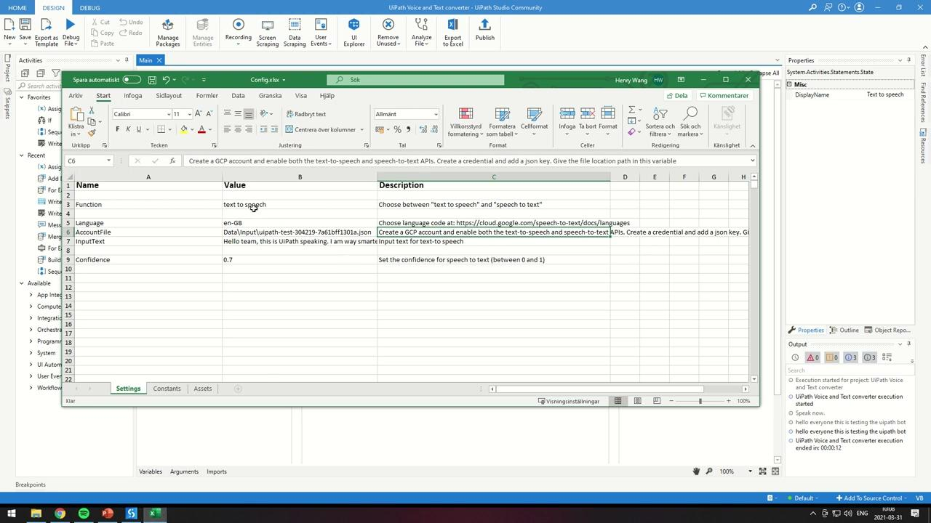
Demo

